Slide 1
About IMT
IMT LLC has been operating in the VAS (Value Added Services) market since 2009. During this time, we have become a content and service provider, a developer and integrator of IT solutions, an application and game developer During this time, we have implemented and are constantly supporting more than 100 solutions for communication operators in Russia, the CIS countries and neighboring countries. We support our own LBS, RBT platforms, eSports products, authorization systems (SSO) for mobile operators, branded USSD, SMS, IVR, WAP portals and services

Slide 2
About esports
Esports is a team or individual competition based on video games In many countries it is recognized as an official sport. Currently, esports is the most dynamic and in-demand direction, and the demand for streaming and video content through mobile applications is also growing Modern esports projects involve the creation of a line of products based on the web (mobile Internet), mobile applications (iOS, Android). That will allow gamers to participate in e-sports events, conduct online broadcasts and watch game video content on any device

Slide 3
Statistics
According to SUPERDATA, the total volume of the eSports market today is about $2 billion. By 2023, this amount will grow to $4 billion The number of viewership for computer and mobile games is more than 500 million people all over the world
Play games
Professional players
Participate in tournaments
Age of players
2.3 billion
450,000
9 million
14-40 years old
Play games
Professional players
Participate in tournaments
Age of players
1.5 billion
200,000
5.5 million
16-45 years old

Slide 4
Current esport Projects

Slide 5
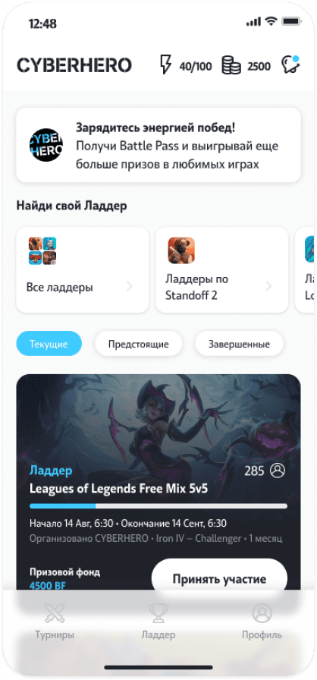
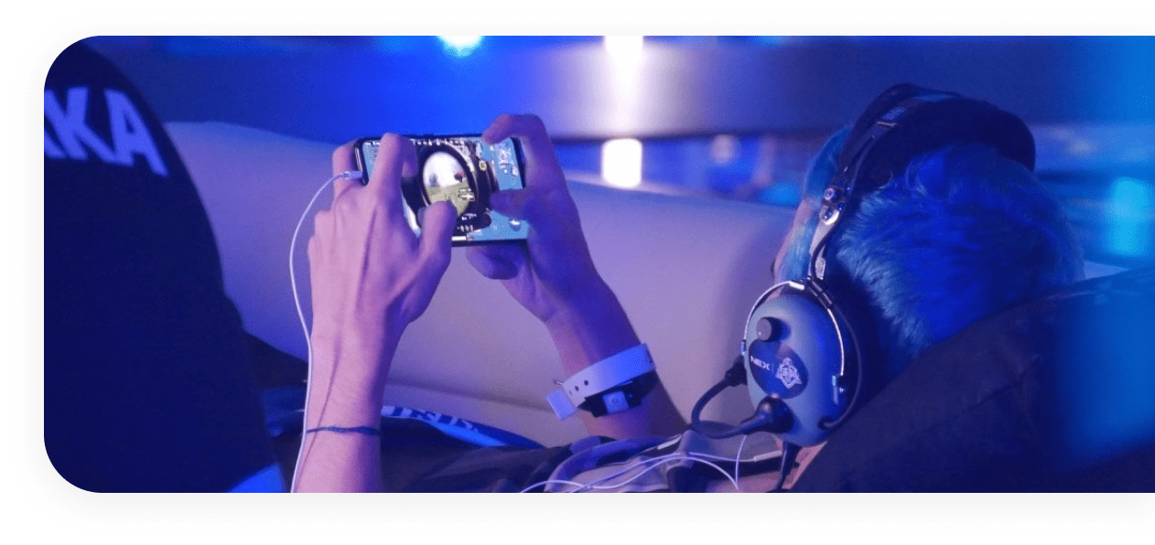
01 Esport projects
CYBERHERO
Tele2 Russia
About product
The platform is one of the three most popular eSports platforms in Russia for Mobile eSports The active audience amounts to 350,000 people. On average, 7000 new users are registered on the portal every week The product provides services in the field of mobile esports, organizing more than 100 major tournaments per month in 20 different disciplines
www.cyberhero.tele2.ru

Slide 6
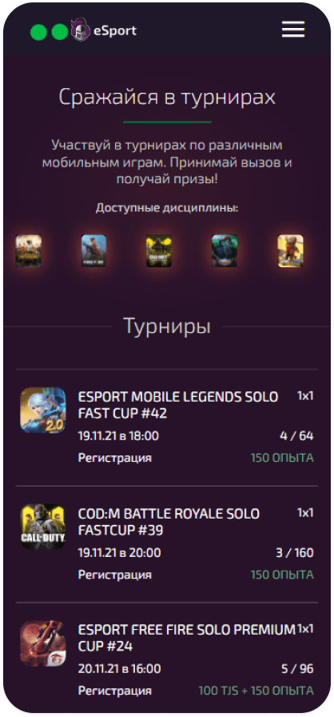
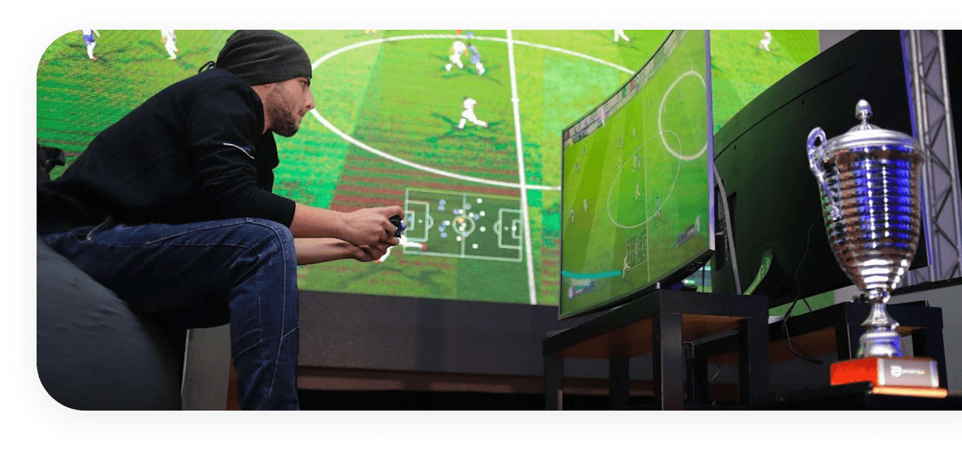
02 Esport projects
ESPORT.TJ
MEGAFON Tajikistan
About product
Киберспортивная площадка, созданная эксклюзивно для мобильного оператора МегаФон Таджикистан Активная аудитория составляет 5 000 игроков Продукт предоставляет услуги в сфере мобильного киберспорта, организовывая более 50 турниров в месяц по 6 популярным дисциплинам
www.esport.tj

Slide 7
Cyberhero Platform

Slide 8
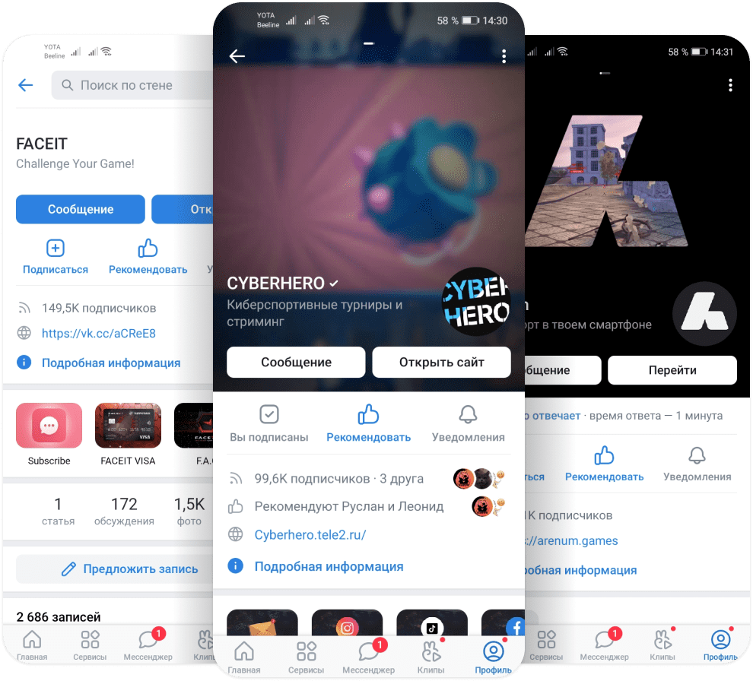
The platform is one of the three most popular esports platforms in Russia
And also, ranks second in Russia in the development of mobile eSports Faceit - active players 1.5 million Arenum - active players 500,000 CYBERHERO - active players 320,000

Slide 9
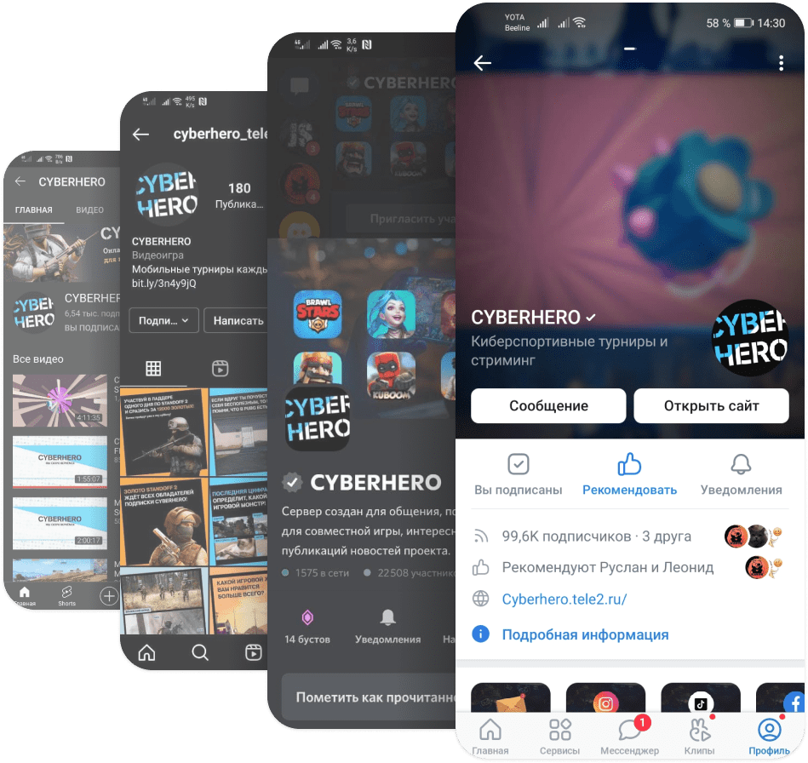
Platform in social communities
Our communities are actively growing and developing Vkontekte - audience of 100,000 users Discord - audience of 25,000 users YouTube - audience of 7000 users We launched communities in Instagram, TikTok, Facebook

Slide 10
Development of eSports platforms

Slide 11
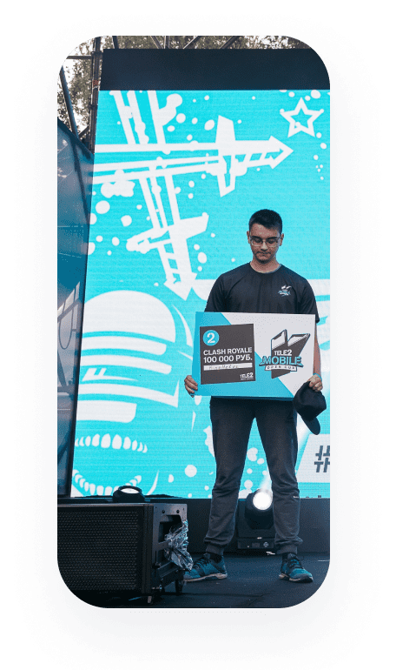
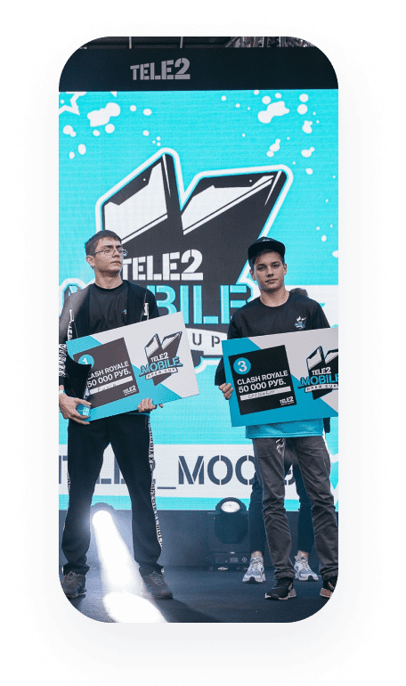
Leagues
Every year we hold the largest mobile esports tournament in Russia. In 2019, the tournament attracted 21,000 new esports players, and in 2020 it was 33,000 The prize fund of the tournament is $20,000 per year. The tournament is watched by over 500,000 people, and the offline event is attended by up to 5,000 fans who want to watch the final games live Our largest esports events are covered by all Russian media

Slide 12
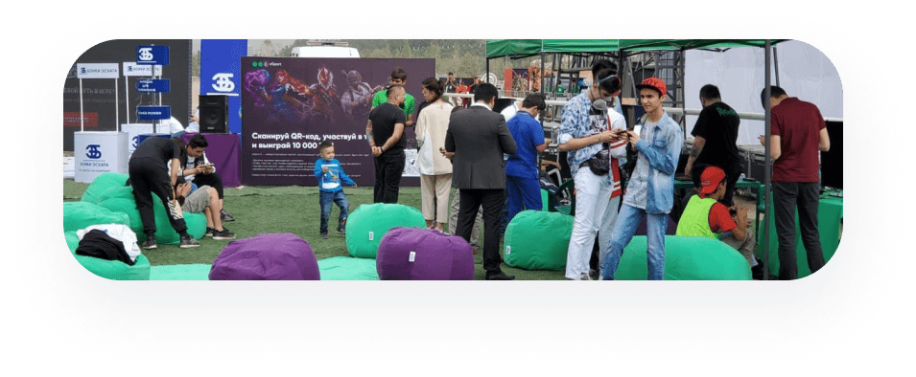
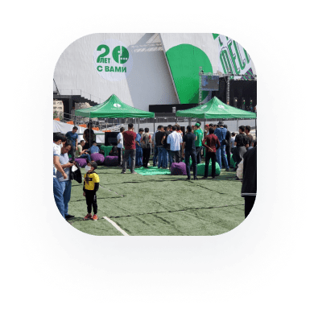
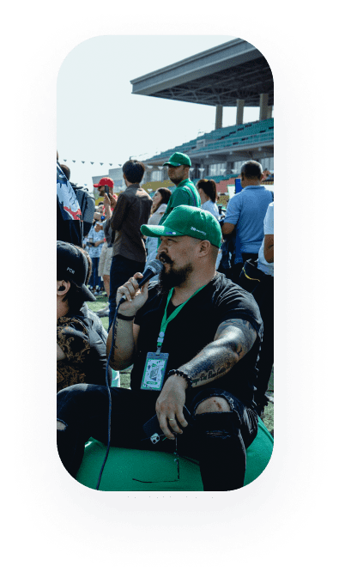
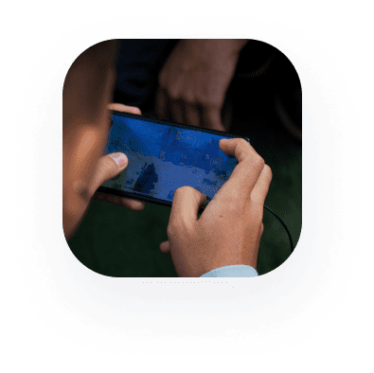
Offline tournament in Tajikistan
This year we held an offline event in Tajikistan called Megafon Fest, which was attended by more than 4500 people, 500 people took part in competitions in various disciplines This event is considered the largest esports-related event in the country

Slide 13
{ "keystone": { "displayName": "Electrocute", "id": 8112, "rawDescription": "perk_tooltip_Electrocute", "rawDisplayName": "perk_displayname_Electrocute" }, "primaryRuneTree": { "displayName": "Domination", "id": 8100, "rawDescription": "perkstyle_tooltip_7200", "rawDisplayName": "perkstyle_displayname_7200" }, "secondaryRuneTree": { "displayName": "Sorcery", "id": 8200, "rawDescription": "perkstyle_tooltip_7202", "rawDisplayName": "perkstyle_displayname_7202" }, "generalRunes": [ { "displayName": "Electrocute", "id": 8112, "rawDescription": "perk_tooltip_Electrocute", "rawDisplayName": "perk_displayname_Electrocute" }, ... ], "statRunes": [ { "id": 5007, "rawDescription": "perk_tooltip_StatModCooldownReductionScaling" }, { "id": 5008, "rawDescription": "perk_tooltip_StatModAdaptive" }, { "id": 5003, "rawDescription": "perk_tooltip_StatModMagicResist" } ] }
API automation
For each game on the platform, we try to implement full automation of the tournament We use the entire set of available API documentation for each project. What helps us to develop our own tools and products for our gaming communities Our proprietary solutions allow us to automate the integration processes with the game for the convenience of the user

Slide 14
We work with many game development companies that provide API licensed to use
BRAWLSTARS - List of matches with results CLASH ROYALE - List of matches with results Gods of Boom - API allows you to create a lobby, invite players there and automatically pick up the match result PUBG - Receiving data from matches without possibility to create a lobby and invite players there Free Fire - Observer mod Pubg mobile - Observer mod LoL - API allows you to create a lobby, invite players there and automatically pick up the match result Brawlhalla - List of matches with results Valorant - List of matches with results SMITE - List of matches with results Paladins - List of matches with results STARCRAFT 2 - List of matches with results
API games for CYBERHERO

Slide 15
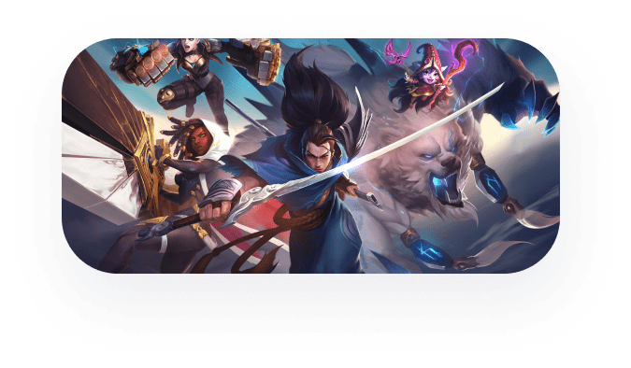
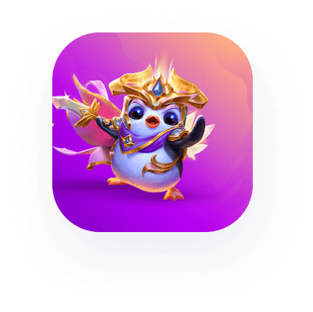
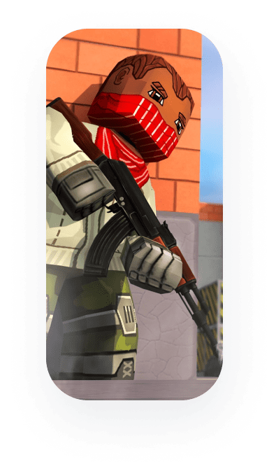
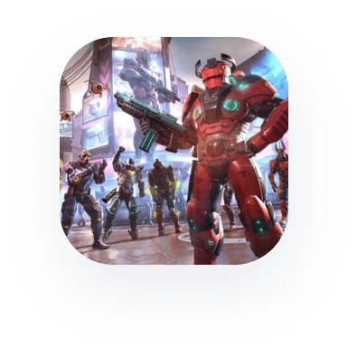
We are actively working with game development partners League of legends
League of Legends Information support of our tournaments League of Legends WILD RIFT Information support of our tournaments TeamFight Tactics Information support of our tournaments Kuboom Information support of our tournaments Information about tournaments in the game SHADOWGUN LEGENDS Exclusive CYBERHERO Bundle that can only be won in our tournaments Information support of our tournaments

Slide 16
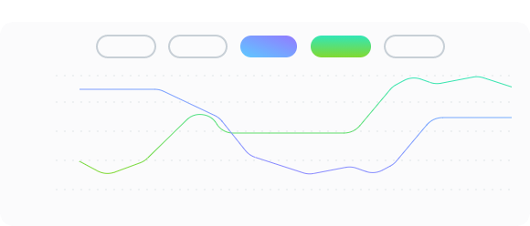
Artificial intelligence
There are games where it is not possible to create process automation using the standard documentation API To solve this problem, we are developing in the field of machine learning. Our artificial intelligence is gaining momentum every day, we are constantly testing and improving our algorithms for automatically conducting tournaments using a bot At this point in time, we have achieved excellent results: our bot is already capable of independently launching game lobbies, inviting tournament participants to a match, launching a tournament, collecting and transmitting results to the server
Neuromodulatorors Activity
Categories:
POP
GLU
SER
DOP
TON
100
75
50
25
0
12:00
12:05
12:10
12:15
12:20
12:25
12:30
12:35
12:40
12:45
12:50
12:55
13:00
13:05
13:10

Slide 17
Cloud solution
Our platforms are leaders in the markets of the Russian Federation and the CIS in organizing and conducting competitions. The total number of registered users is over 300,000 users. Every month we hold more than 100 major tournaments in 20 game disciplines. The monthly prize pool is over $ 7000 The main features of our platform: Organization of tournaments Organization of leagues Ladder organization Streaming organization Organization of quick matches and duel Automation of launching matches and getting results Artificial intelligence as a tournament organizer Product monetization

Slide 18
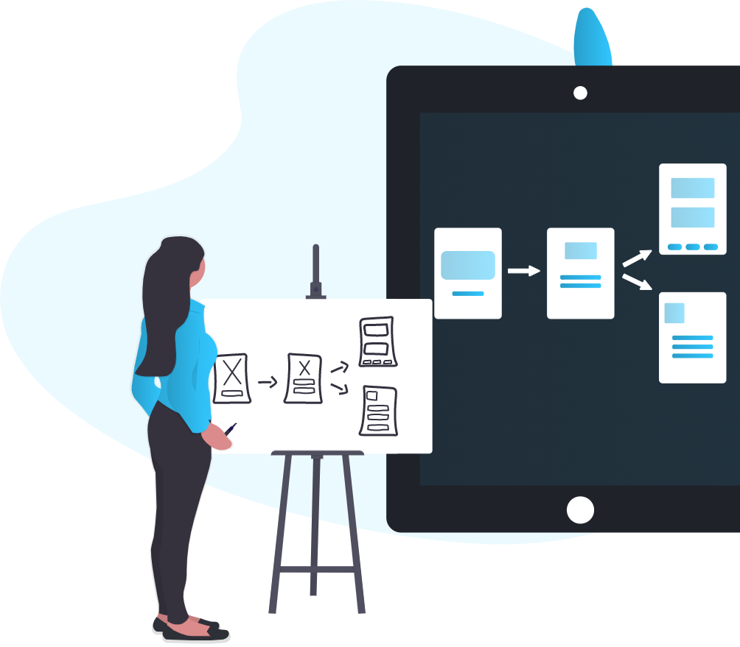
Offer
1. Creation of a full-scale e-sports platform under the brand of your company. The platform will allow holding tournaments in different disciplines (games), in all popular formats and on major platforms (PC, Mobile) 2. Organization of broadcasts in high quality on the product's own servers 3. We will provide development, technical support and promotion

Slide 19
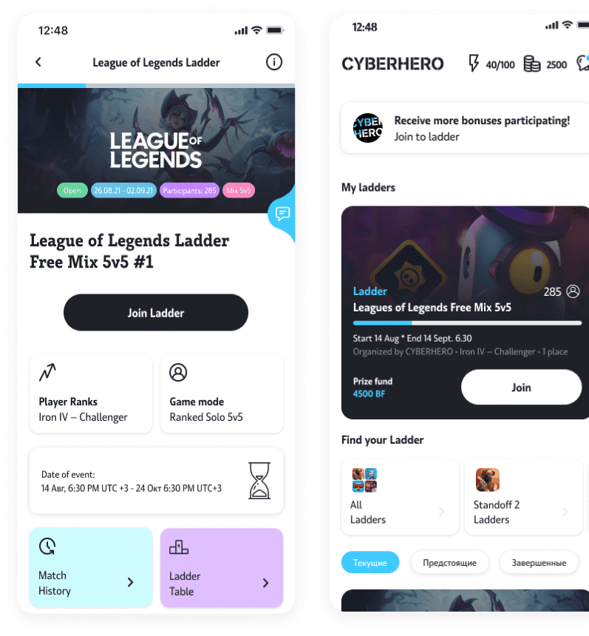
Weekly Ladders
Ladders are gaming arenas where anyone can test their strength in duels and on battlefields. For victories in games, players are awarded points, and at the end of the Ladder period, the most productive players will receive cash prizes and other gifts We rotate several Ladders in different game disciplines every week. The total prize pool is $ 2,000 per month. Thousands of active users strive to win prizes in such championships

Slide 20
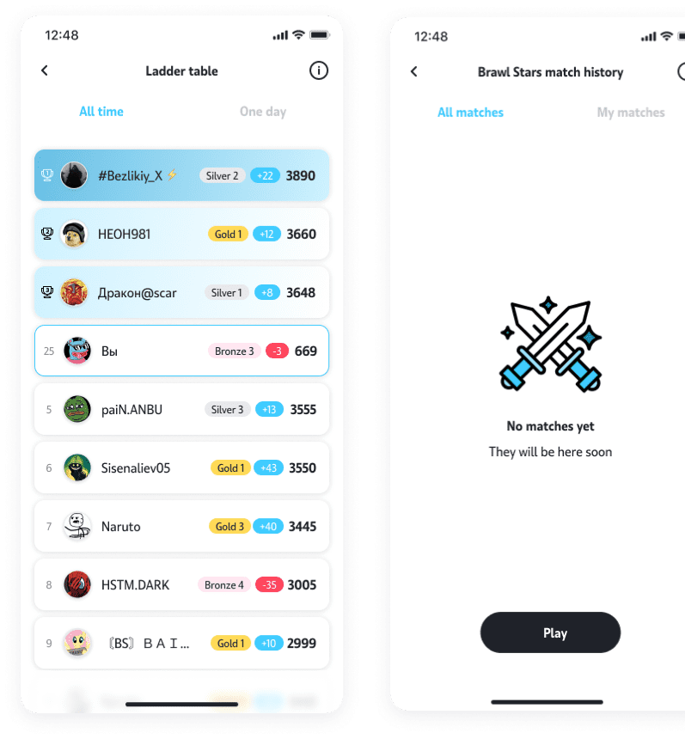
Daily Tournaments
Our platform allows to conduct several parallel tournaments per day. The system uses all types of game nets, keeps track of the ratings of the players, which allows you to create separate leader boards for each game discipline We are able to host both one-time tournaments and tournaments with qualifying matches for larger events!

Slide 21
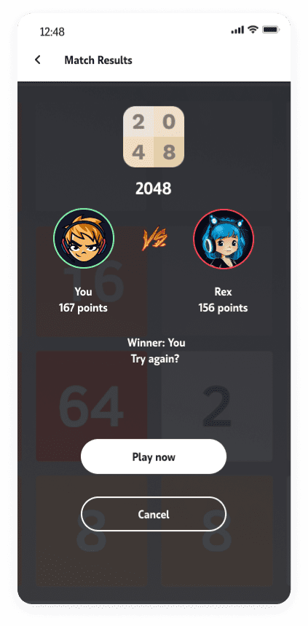
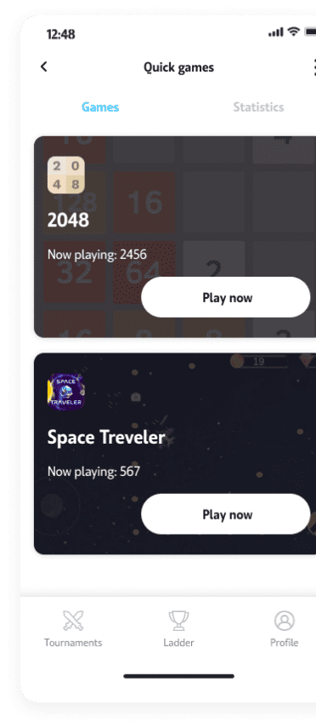
Duels and Quick matches
The principle of this system is very simple: players choose a game and find opponents through the search system. The player's task is to score maximum points on the first try The winner takes the prize, and the loser can try again with a different opponent. Tournaments of this mode are held for top games with a cybersport theme and for other games with a large number of users

Slide 22
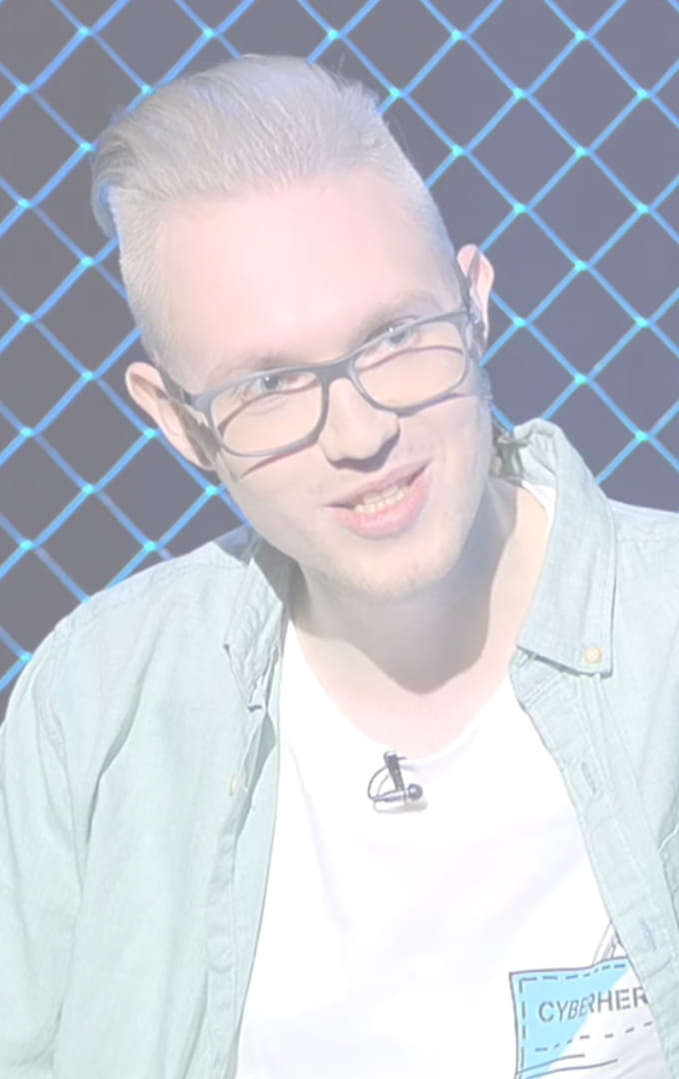
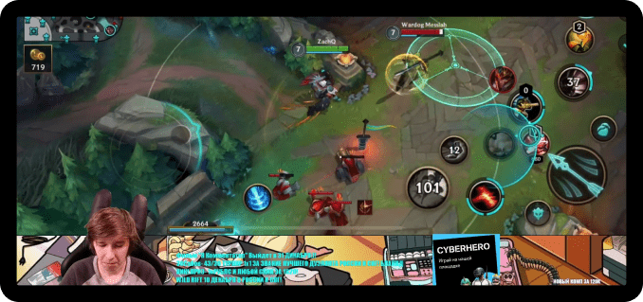
Live broadcasts
The platform enables users to make live broadcasts. The system runs on a stack of our video encoding technologies We can compete with such market giants as YouTube or Twitch The platform allows you to record broadcasts of games, IRL events. The user can record and download high quality files The platform has a service for creating a user's own channel for broadcasting, with the functionality of personal chats Video Production of our own tournaments is created in our live broadcast studios

Slide 23
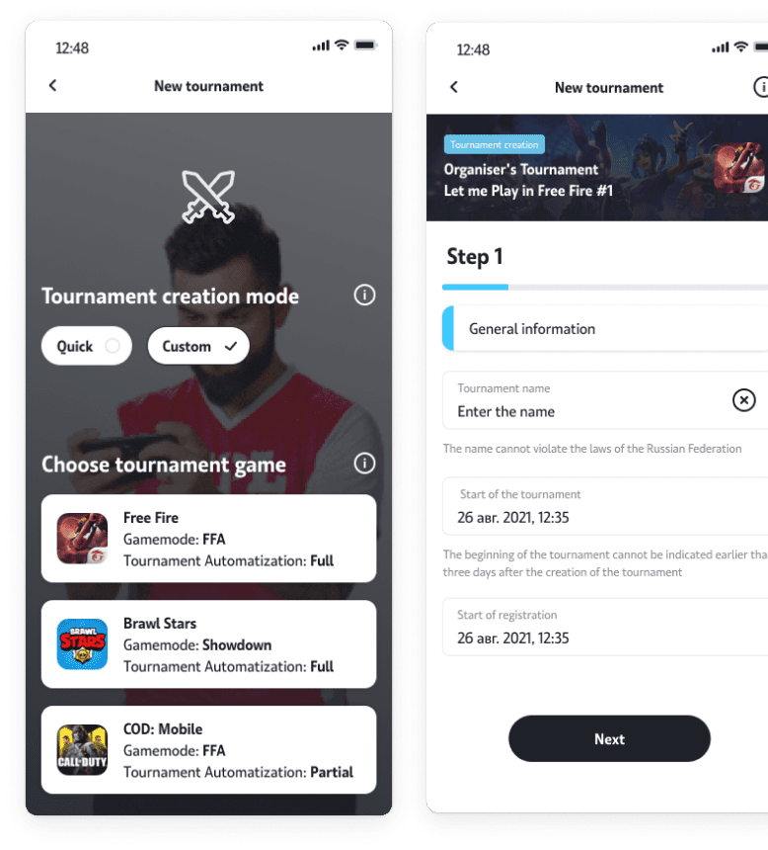
Custom Tournaments
We enable the user to conduct their own tournaments or competitions of any difficulty level on our platform This function is interesting for game bloggers, companies (for tournaments between employees), and other communities For this, the Control Panel has been implemented. Participants do not have to worry about the payment of cash prizes, the portal guarantees payments and ensures the storage of the prize pool of custom tournaments

Slide 24
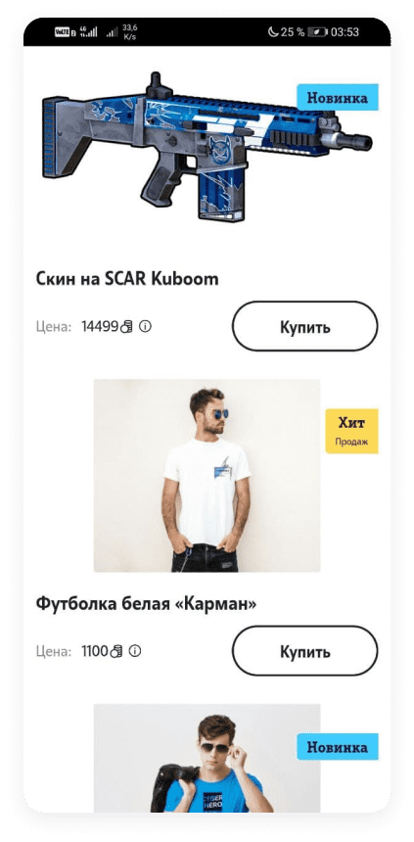
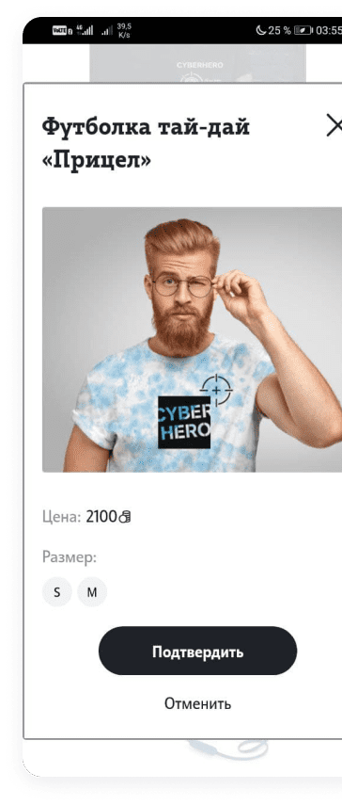
Shop
We are ready to offer you a complete solution for organizing an e-sports online store for your Brand Store products: electronic goods of a gaming theme, in-game currencies, assets, and exclusive offers from developers of top games, branded merchandise of the company and platform

Slide 25
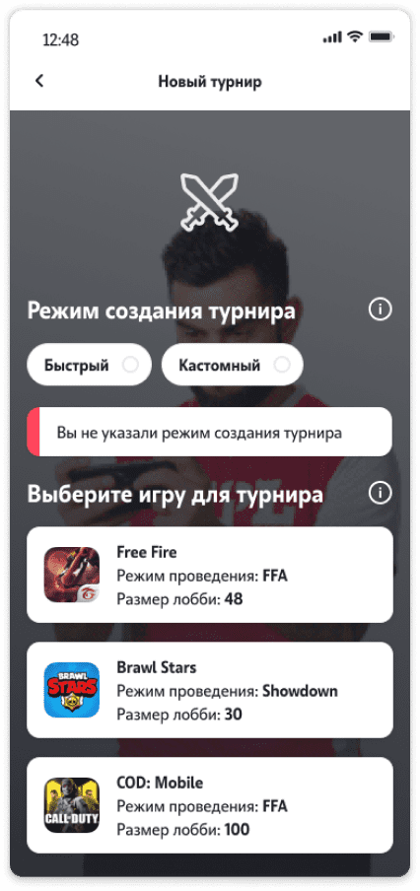
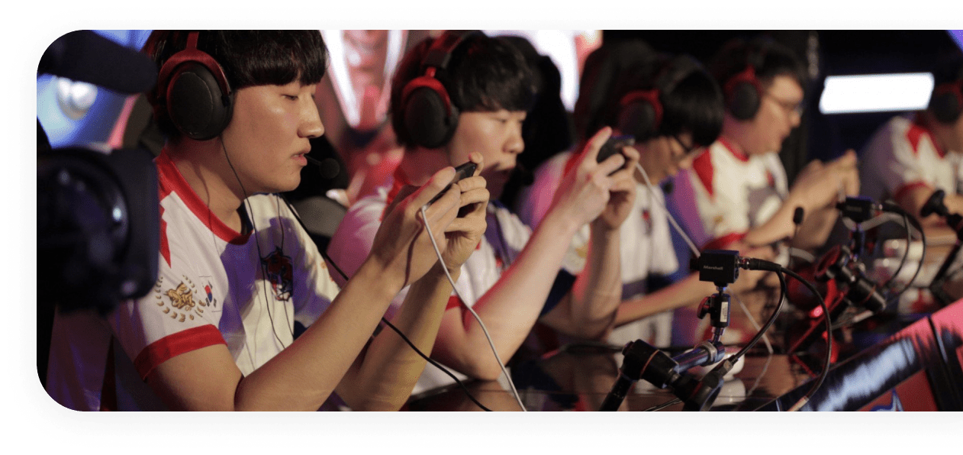
01 Functional development
Option - Web Games
Project objective
Provide players with an extensive database of WEB games powered by Open Source The main service will be the competition system built into every game from the catalog. Users will be able to perform a quick search for opponents and play quick games where the main task will be to score points The winner with the most points will claim the prize

Slide 26
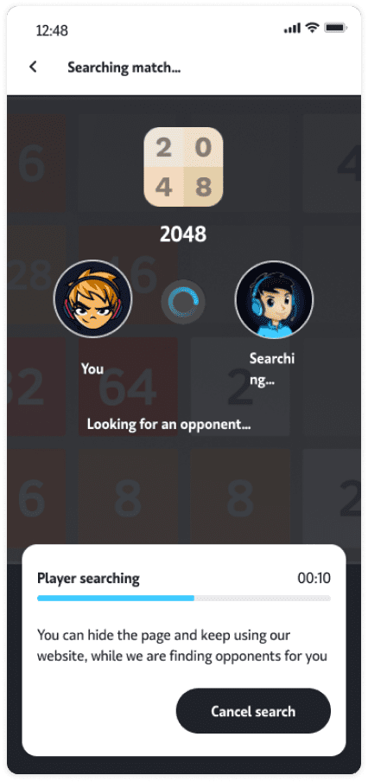
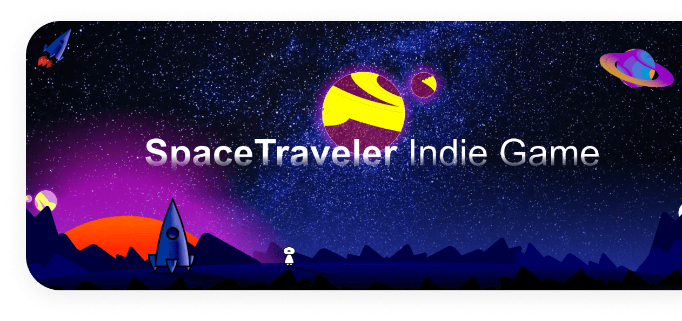
02 Functional development
Option - Web Games
Project objective
Provide players with an extensive database of WEB games powered by Open Source The main service will be the competition system built into every game from the catalog. Users will be able to perform a quick search for opponents and play quick games where the main task will be to score points The winner with the most points will claim the prize

Slide 27
Branding examples in the games

Slide 28
Exclusive offer with RIOT GAMES
RIOT GAMES – the developer of the League of Legends computer game The audience of the game is over 100 million players around the world Exclusive conditions for the sale of full UNLOCK game skins for a user account and a license to use the game API

Slide 29
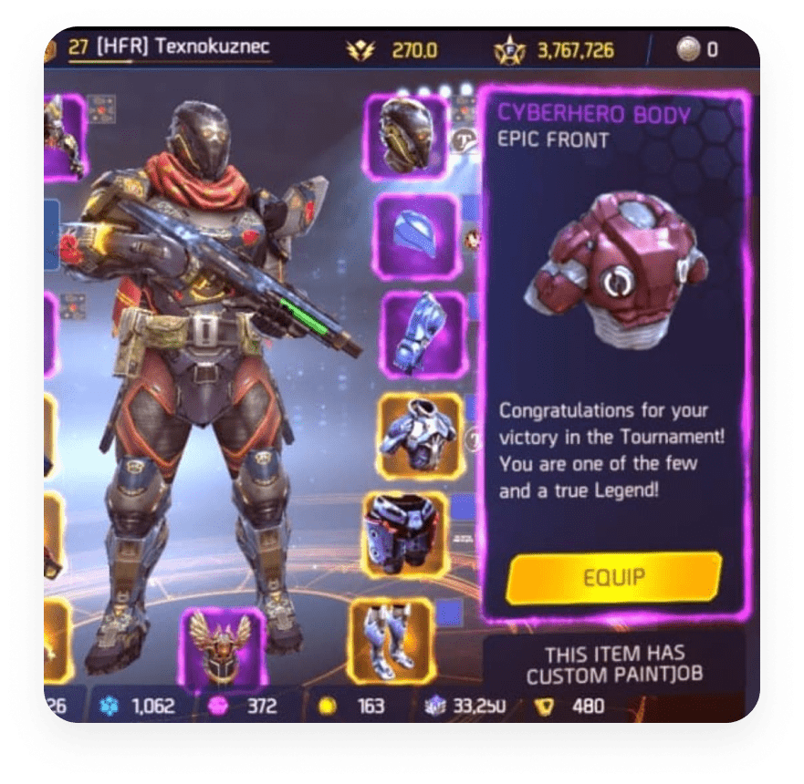
Exclusive offer with MADFINGER GAMES
MADFINGER GAMES – the developer of the mobile game Shadowgun Legends The audience of the game is more than 10 million players around the world Provides an exclusive CYBERHERO bundle that can only be won in our tournaments

Slide 30
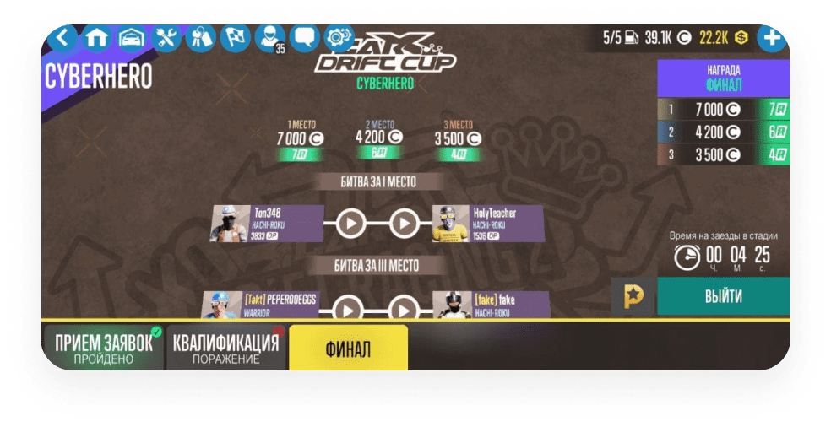
Exclusive offer with CARX-TECH
CARX-TECH – the developer of the mobile game CarX Drift Racing The audience of the game is over 20 million players around the world Provides exclusive conditions for the full automation of CYBERHERO tournaments through the game client

Slide 31
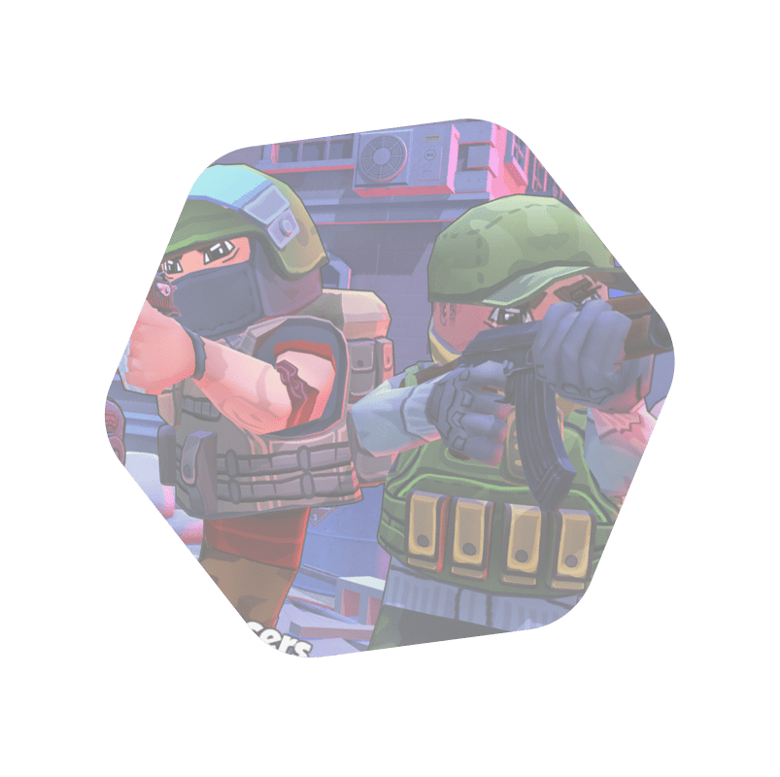
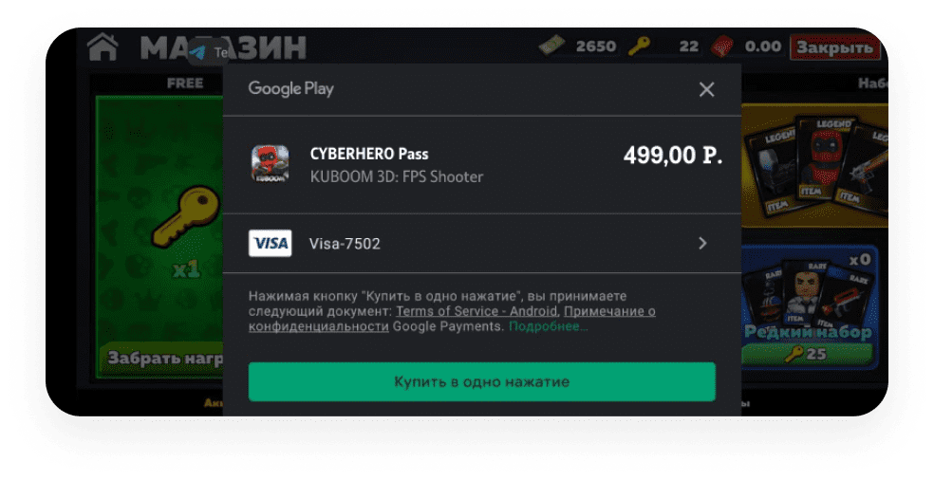
Exclusive offer with NOBODYSHOT
NOBODYSHOT is the developer of the mobile game Kuboom The audience of the game is over 10 million players around the world Provides exclusive conditions for creating an in-game personalized subscription for players, which opens up more opportunities for them to participate in tournaments

Slide 32
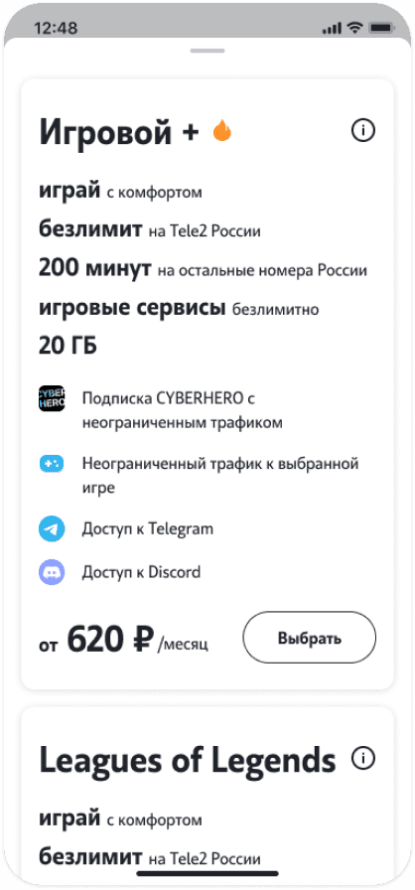
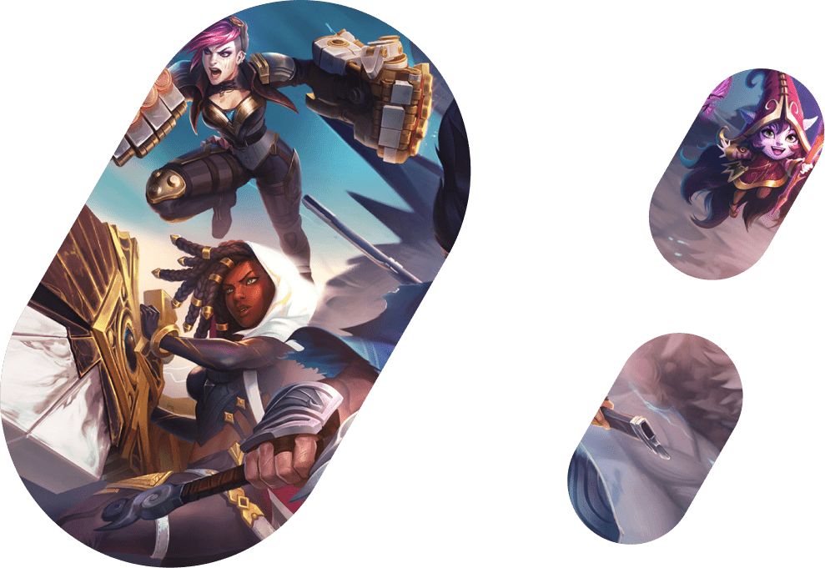
Tariff plans
Game options from IMT and partners Tariff content from Tele2

Slide 33
Monetization
Main models: $ Monthly subscription model $ Intraportal currency model Paid subscriptions provide benefits and bonuses over non-subscription users. For example: access to all paid tournaments, in-game gifts, access to the best quality broadcasts, discounts in the store, etc Players can earn currency by participating in short competitions with each other
Хит
продаж
Purchase
Cyberbuff PRO
129
119
₽
/per month
₽
/ per month
30 day subscription Access to all tournaments 129 buffs every month Gifts: rub+buffs Gifts from Kaboom and Mobile Legendsto choose
30 day subscription Access to all tournaments 119 buffs every month Gifts: rub+buffs Only for Tele2 subscribers
Buy
Activate

Slide 34
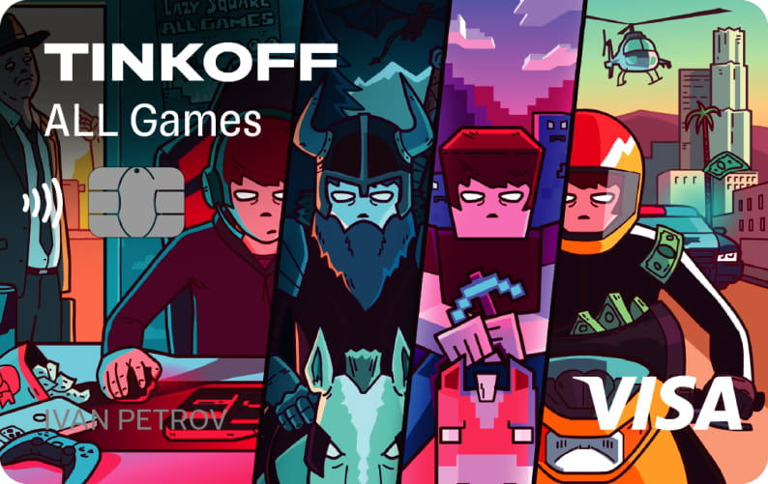
B2B
To create a powerful Service for your Brand, we plan to develop the b2b direction by organizing tournaments and other events with the support of third-party brands The platform will allow your partner companies to conduct their own tournaments, ladders and leagues in automatic mode, as well as involve the Imtechnologies team for holding tournaments. At the moment, we have already used similar brand collaborations in the Russian market

Slide 35
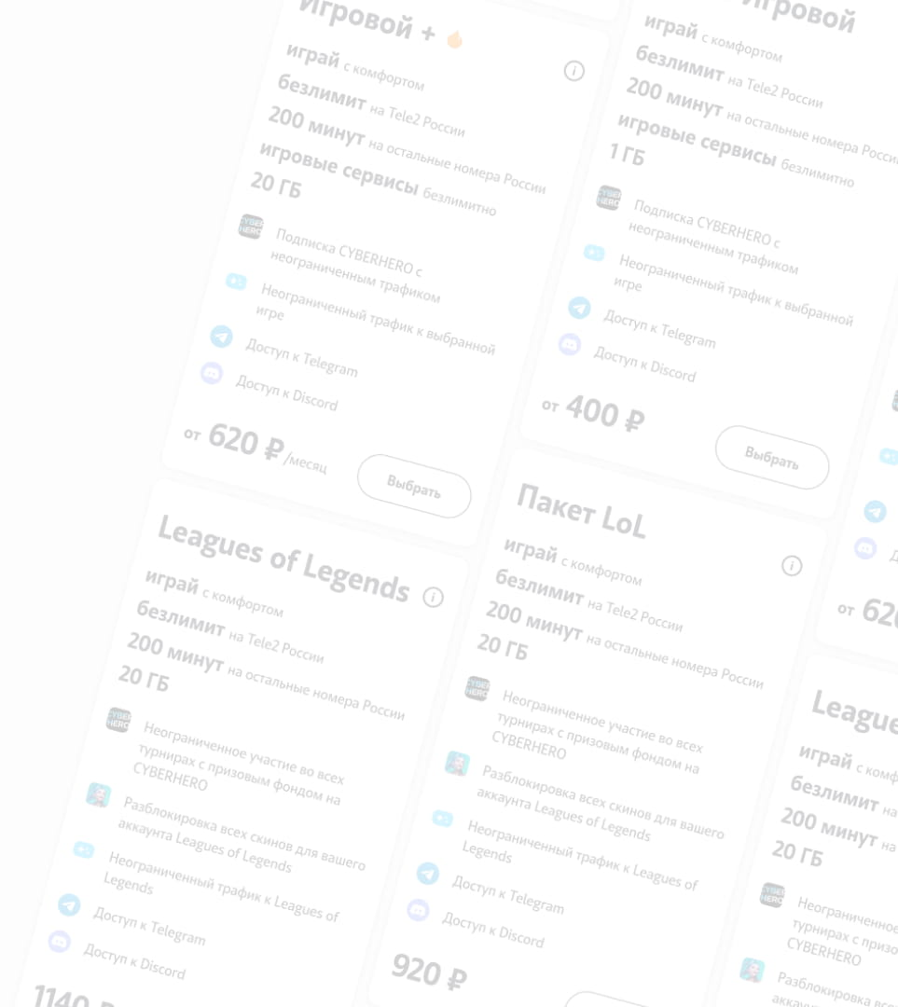
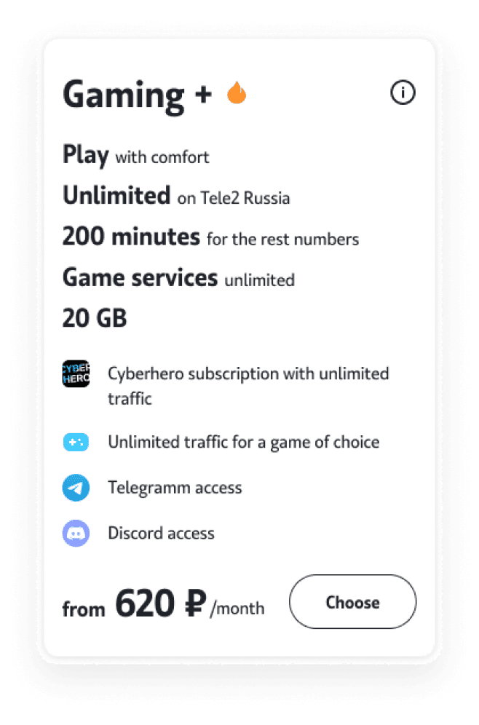
Tariff «‎Gaming+»
Tariff benefits
Connect the tariff and activate the game option to receive exclusive offers at a great price. The tariff is filled from the in-game currency in the selected game. For the first time, Tariff "Gaming+" is available from a mobile operator without being tied to a home Internet. You no longer need a connection to a modem and a communication line Unlimited traffic on the portal and in CYBERHERO applications CYBERHERO subscription is included in the price of the tariff Unlimited calls within the Tele2 network in Russia The same price for the "Game" tariff in all available regions For residents of Moscow and a number of regions there is a unique opportunity to connect "Gaming" via eSIM

Slide 36
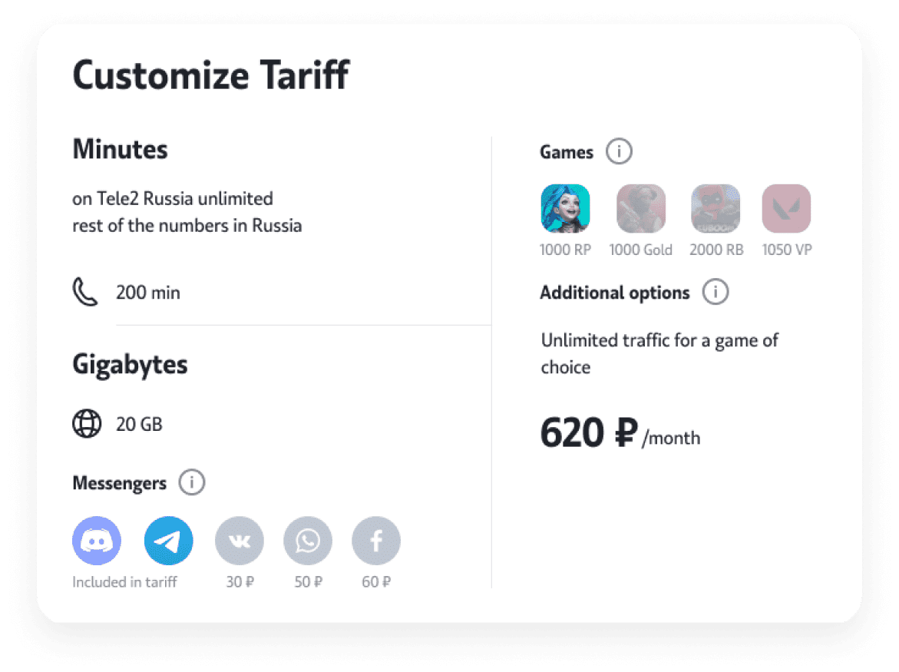
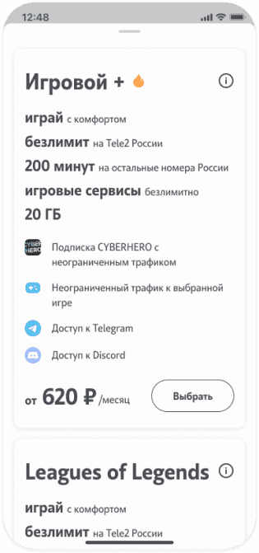
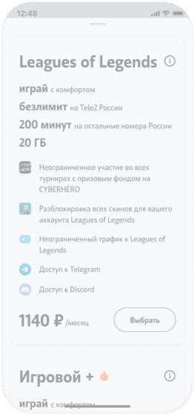
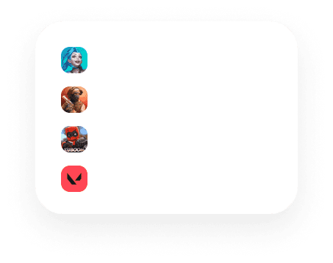
Tariff «‎Gaming+»
119 ₽
/user benefit
119 ₽
/user benefit
119 ₽
/user benefit
119 ₽
/user benefit

Slide 37
We offer our users a choice of in-game currency
Work has already been established to supply services in such well-known disciplines as: Kuboom, Standoff 2, MLBB, PUBG Mobile, Free Fire A client who pays for a subscription on the portal pays for it with this bonus in full
Attracting subscribers through the inclusion of in-game currencies
Special promo campaign
To promote the type of subscription with in-game currency, we use landing pages, as well as ad units that are shown for the client by certain triggers
Visit the landing page
Check out the scripts

Slide 38
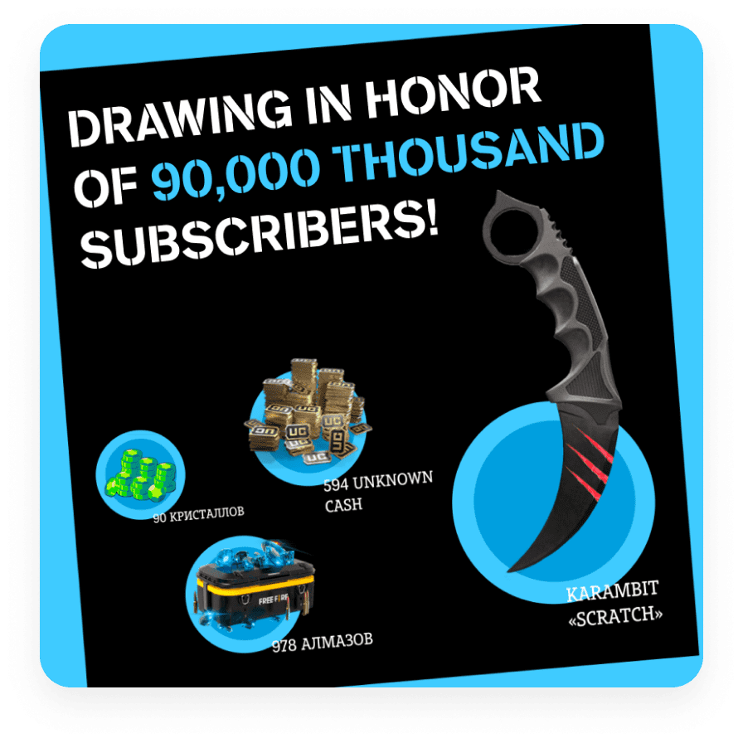
Social Media
For each of our projects, we create and support groups on all popular social networks. Thanks to this, we receive feedback from users and additional free channels for promoting your product. Our largest social media bases reach 100,000 people We provide the ability to register your users on the portal through all popular social networks

Slide 39
Technical support
Any major esports product from our company has its own Help Center. The support service has a portal FAQ, tutorial articles and video instructions If the user did not find the answer to his question, he can write a message to the support department, which is processed within 24 hours from the moment the request was sent. We provide support to users in their native language

Slide 40
Why Us?
Many years of experience, a professional team, proprietary technologies, a creative approach to tasks, a large contact base - everything you need to successfully implement your product
TEAM
STAFF
We have a large team of professionals capable of performing a task of any complexity. We are able to support the full development cycle on our own, from the technical implementation of the project to marketing
Own staff of eSports referees, which is necessary for those disciplines where there are controversial moments or live refereeing is required. Our judges have documents confirming their Suide category
CONTACTS
AN EXPERIENCE
For 3 years of work, we have received the support of the main game developers in Russia, the CIS, Europe, Asia and America (more than 30 companies). This support gives us the ability to automatically run tournaments and get the final results, which eliminates the factor of human error
We are a developer, administrator and promoter of eSports portals for Russia and the CIS. We have been working with the esports industry since 2018

